Slide 1
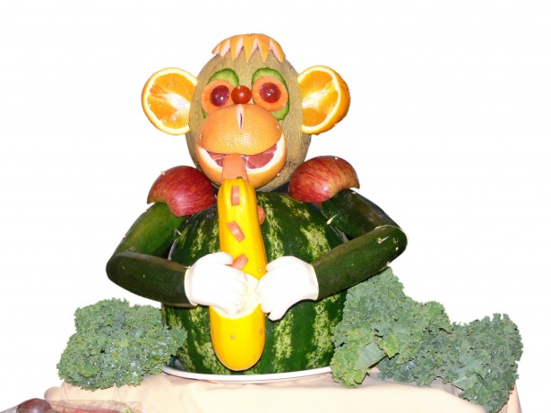
FIRST & PRIMARY SCHOOL
MENU 2024
WEEK ONE
 | Monday | Tuesday | Wednesday | Thursday | Friday
Main Course Choices
Potatoes Pasta/Rice
Vegetables
Salad Bowl
Starters or Sweets
Spaghetti Bolognaise
Jacket Potato with a Choice of Fillings
Chicken Curry
Jacket Potato with a Choice of Fillings
Roast Gammon Dinner with Yorkshire Pudding
Jacket Potato with a Choice of Fillings
Meat Balls in Tomato and Basil Pasta Sauce
Jacket Potato with a Choice of Fillings
Chicken Nuggets
Jacket Potato with a Choice of Fillings
Garlic Bread
Basmati Rice
Roast Potato
Pasta
Chips
Seasonal Vegetables
Seasonal Vegetables
Seasonal Vegetables
Seasonal Vegetables
Seasonal Vegetables
Seasonal Salad
Seasonal Salad
Seasonal Salad
Seasonal Salad
Seasonal Salad
Home Made Biscuit with a Glass of Milk or Juice
Orange Muffin
Strawberry Angel Delight
Chocolate Cake
Pudding of the Day
Fresh Fruit and a selection of Breads are always available daily
Drinking Water is Available Daily on the Dining Room Tables
Menus are Subject to Change

Slide 2
FIRST & PRIMARY SCHOOL
MENU 2024
WEEK TWO
 | Monday | Tuesday | Wednesday | Thursday | Friday
Main Course Choices
Potatoes Pasta / Rice |  |  |  |  | Chips
Vegetables
Salad Bar |  |  | Seasonal Salad
Starters or Sweets
Pizza
Jacket Potato with a Choice of Fillings
Beef Burger in Bread Bun
Jacket Potato with a Choice of Fillings
Italian Chicken
Jacket Potato with a Choice of Fillings
Fish Fingers
Jacket Potato with a Choice of Fillings
Roast Gammon with Yorkshire Pudding
Jacket Potato with a Choice of Fillings
Potato Wedges
Mashed Potato
Roast Potatoes
Basmati Rice
Seasonal Vegetables
Seasonal Vegetables
Seasonal Vegetables
Seasonal Vegetables
Seasonal Vegetables
Seasonal
Salad
Seasonal
Salad
Seasonal
Salad
Seasonal
Salad
Homemade Biscuit with Juice/Milk
Chocolate Muffin
Cheesecake
Grapes, Cheese and Digestive Biscuit
Pudding of the Day
Fresh Fruit and a selection of Breads are always available daily
Drinking Water is Available Daily on the Dining Room Tables
Menus are Subject to Change

Slide 3
FIRST & PRIMARY SCHOOL
MENU 2024
WEEK THREE
 | Monday | Tuesday | Wednesday | Thursday | Friday
Main Course Choices
Potatoes Pasta / Rice
Vegetables
Salad Bar
Starters or Sweets | Chocolate Brownie
Fishcakes
Jacket Potato with a Choice of Fillings
Roast Gammon and Yorkshire Pudding
Jacket Potato with a Choice of Fillings
Chicken Nuggets
Jacket Potato with a Choice of Fillings
Meatballs in Tomato and Basil Pasta Sauce
Jacket Potatoes with a Choice of Fillings
Pork Sausage
Jacket Potato with a Choice of Fillings
Potato Waffles
Mashed Potato
Roast Potato
Pasta
Chips
Seasonal Vegetables
Seasonal Vegetables
Seasonal Vegetables
Seasonal Vegetables
Seasonal Vegetables
Seasonal
Salads
Seasonal
Salads
Seasonal
Salads
Seasonal
Salads
Seasonal
Salads
Homemade Biscuit with
Glass of Milk /Juice
Chocolate Angel Delight
Pudding of the Day
Blueberry Muffin
Fresh Fruit and a selection Breads are always available daily
Drinking Water is Available Daily on the Dining Room Tables
Menus are Subject to Change

